Slide 1


Slide 2
CSquare PROJECT
LAPTOP TABLE

Slide 3
TEAM MEMBERS:
Sachin Rustagi : 121601022
Pavan Chandra : 121701019
Sai Srujan : 101701007
Phanindra : 121701030
Edla Lekhana : 121701008
MENTOR: Aravind Ajoy , Asst.prof , EE.

Slide 4
PROBLEM STATEMENT:
Computer Table to use a laptop while bedridden :
People who are bed ridden often wish to use their laptop. It will be nice to make an ergonomic computer table whose height and angle can be adjusted by the user. Thought also must be given for use of the keyboard and mouse.

Slide 5
SPECIFICATIONS:
The table is completely automatic i.e., no manual work is required
The height and angle change at the same time
Angle of the plank can be changed as per the users convenience
Any size laptop can be fixed to the table
A separate place is allotted to use a mouse

Slide 6
MECHANISM:
Height of the plank:
C jaws move up and down with the help of worm gears driven by stepper motors attached to both the legs.
Angle of the plank:
A slider is placed at the right edge of the plank. This is attached to a lead screw which rotates with the help of another stepper motor.

Slide 7
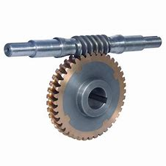
WHY WORM GEAR?
A worm drive can reduce rotational speed or transmit higher torque
The direction of transmission (input shaft vs output shaft) is not reversible

Slide 8
Stepper motors:
High reliability, high torque at low speeds.
A wide range of rotational speeds can be achieved.
The motor has full torque at standstill (if the windings are energized)
stepper motor has better position precision and good repetitive action.

Slide 9

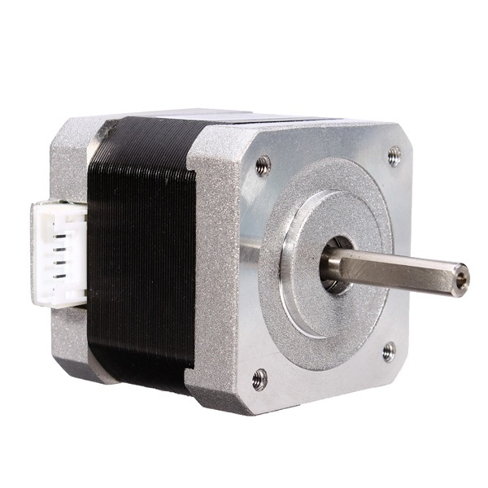
NEMA-17
Type : bipolar hybrid
Voltage : 2.55V
Current : 1.7A
Torque : 4.2 Kg-cm
Step angle : 1.8

Slide 10
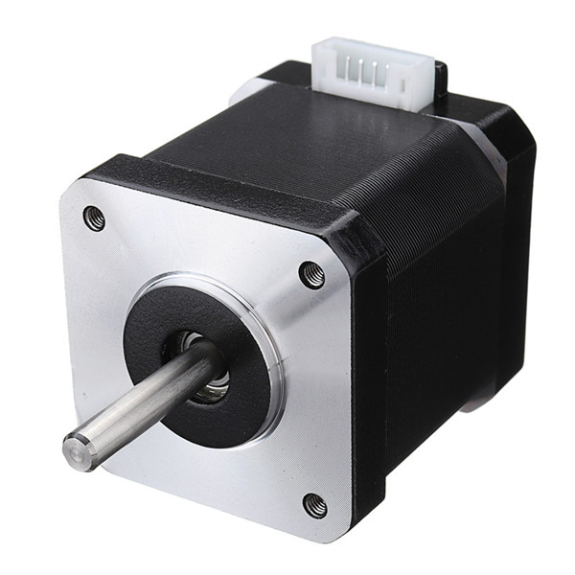
NEMA-17 42
Height adjustment::
Type : bipolar
Voltage : 2.55V
Current : 1.7A
Torque : 5.5 Kg-cm
Step angle : 1.8

Slide 11
PROGRAMMING:
#include <Stepper.h> const int stepsPerRevolution = 200; int push1 = A0; int push2 = A1; int push3 = A2; int push4 = A3; //int count = 0; Stepper myStepper1(stepsPerRevolution, 10, 11, 12, 13); Stepper myStepper2(stepsPerRevolution, 6, 7, 8, 9); Stepper myStepper3(stepsPerRevolution, 2, 3, 4, 5);
void loop() {
if(digitalRead(push1) == LOW )//&& count <= 20000 ) { myStepper1.step(1); myStepper2.step(1); // count++; } if(digitalRead(push2) == LOW )//&& count >= 0){ { myStepper1.step(-1); myStepper2.step(-1); // count--; } if(digitalRead(push3) == LOW){ myStepper3.step(1); } if(digitalRead(push4) == LOW){ myStepper3.step(-1); } }
void setup() {
pinMode(push1 , INPUT_PULLUP); pinMode(push2 , INPUT_PULLUP); pinMode(push3 , INPUT_PULLUP); pinMode(push4 , INPUT_PULLUP);
myStepper1.setSpeed(25); myStepper2.setSpeed(25); myStepper3.setSpeed(75); Serial.begin(9600); }

Slide 12

PROGRAMMING:
3 motors are programmed using a single Arduino::
Jaws :
Upward: A0=Low
Download :A1=Low
Plank :
ACW: A2=Low
CW: A3=Low

Slide 13
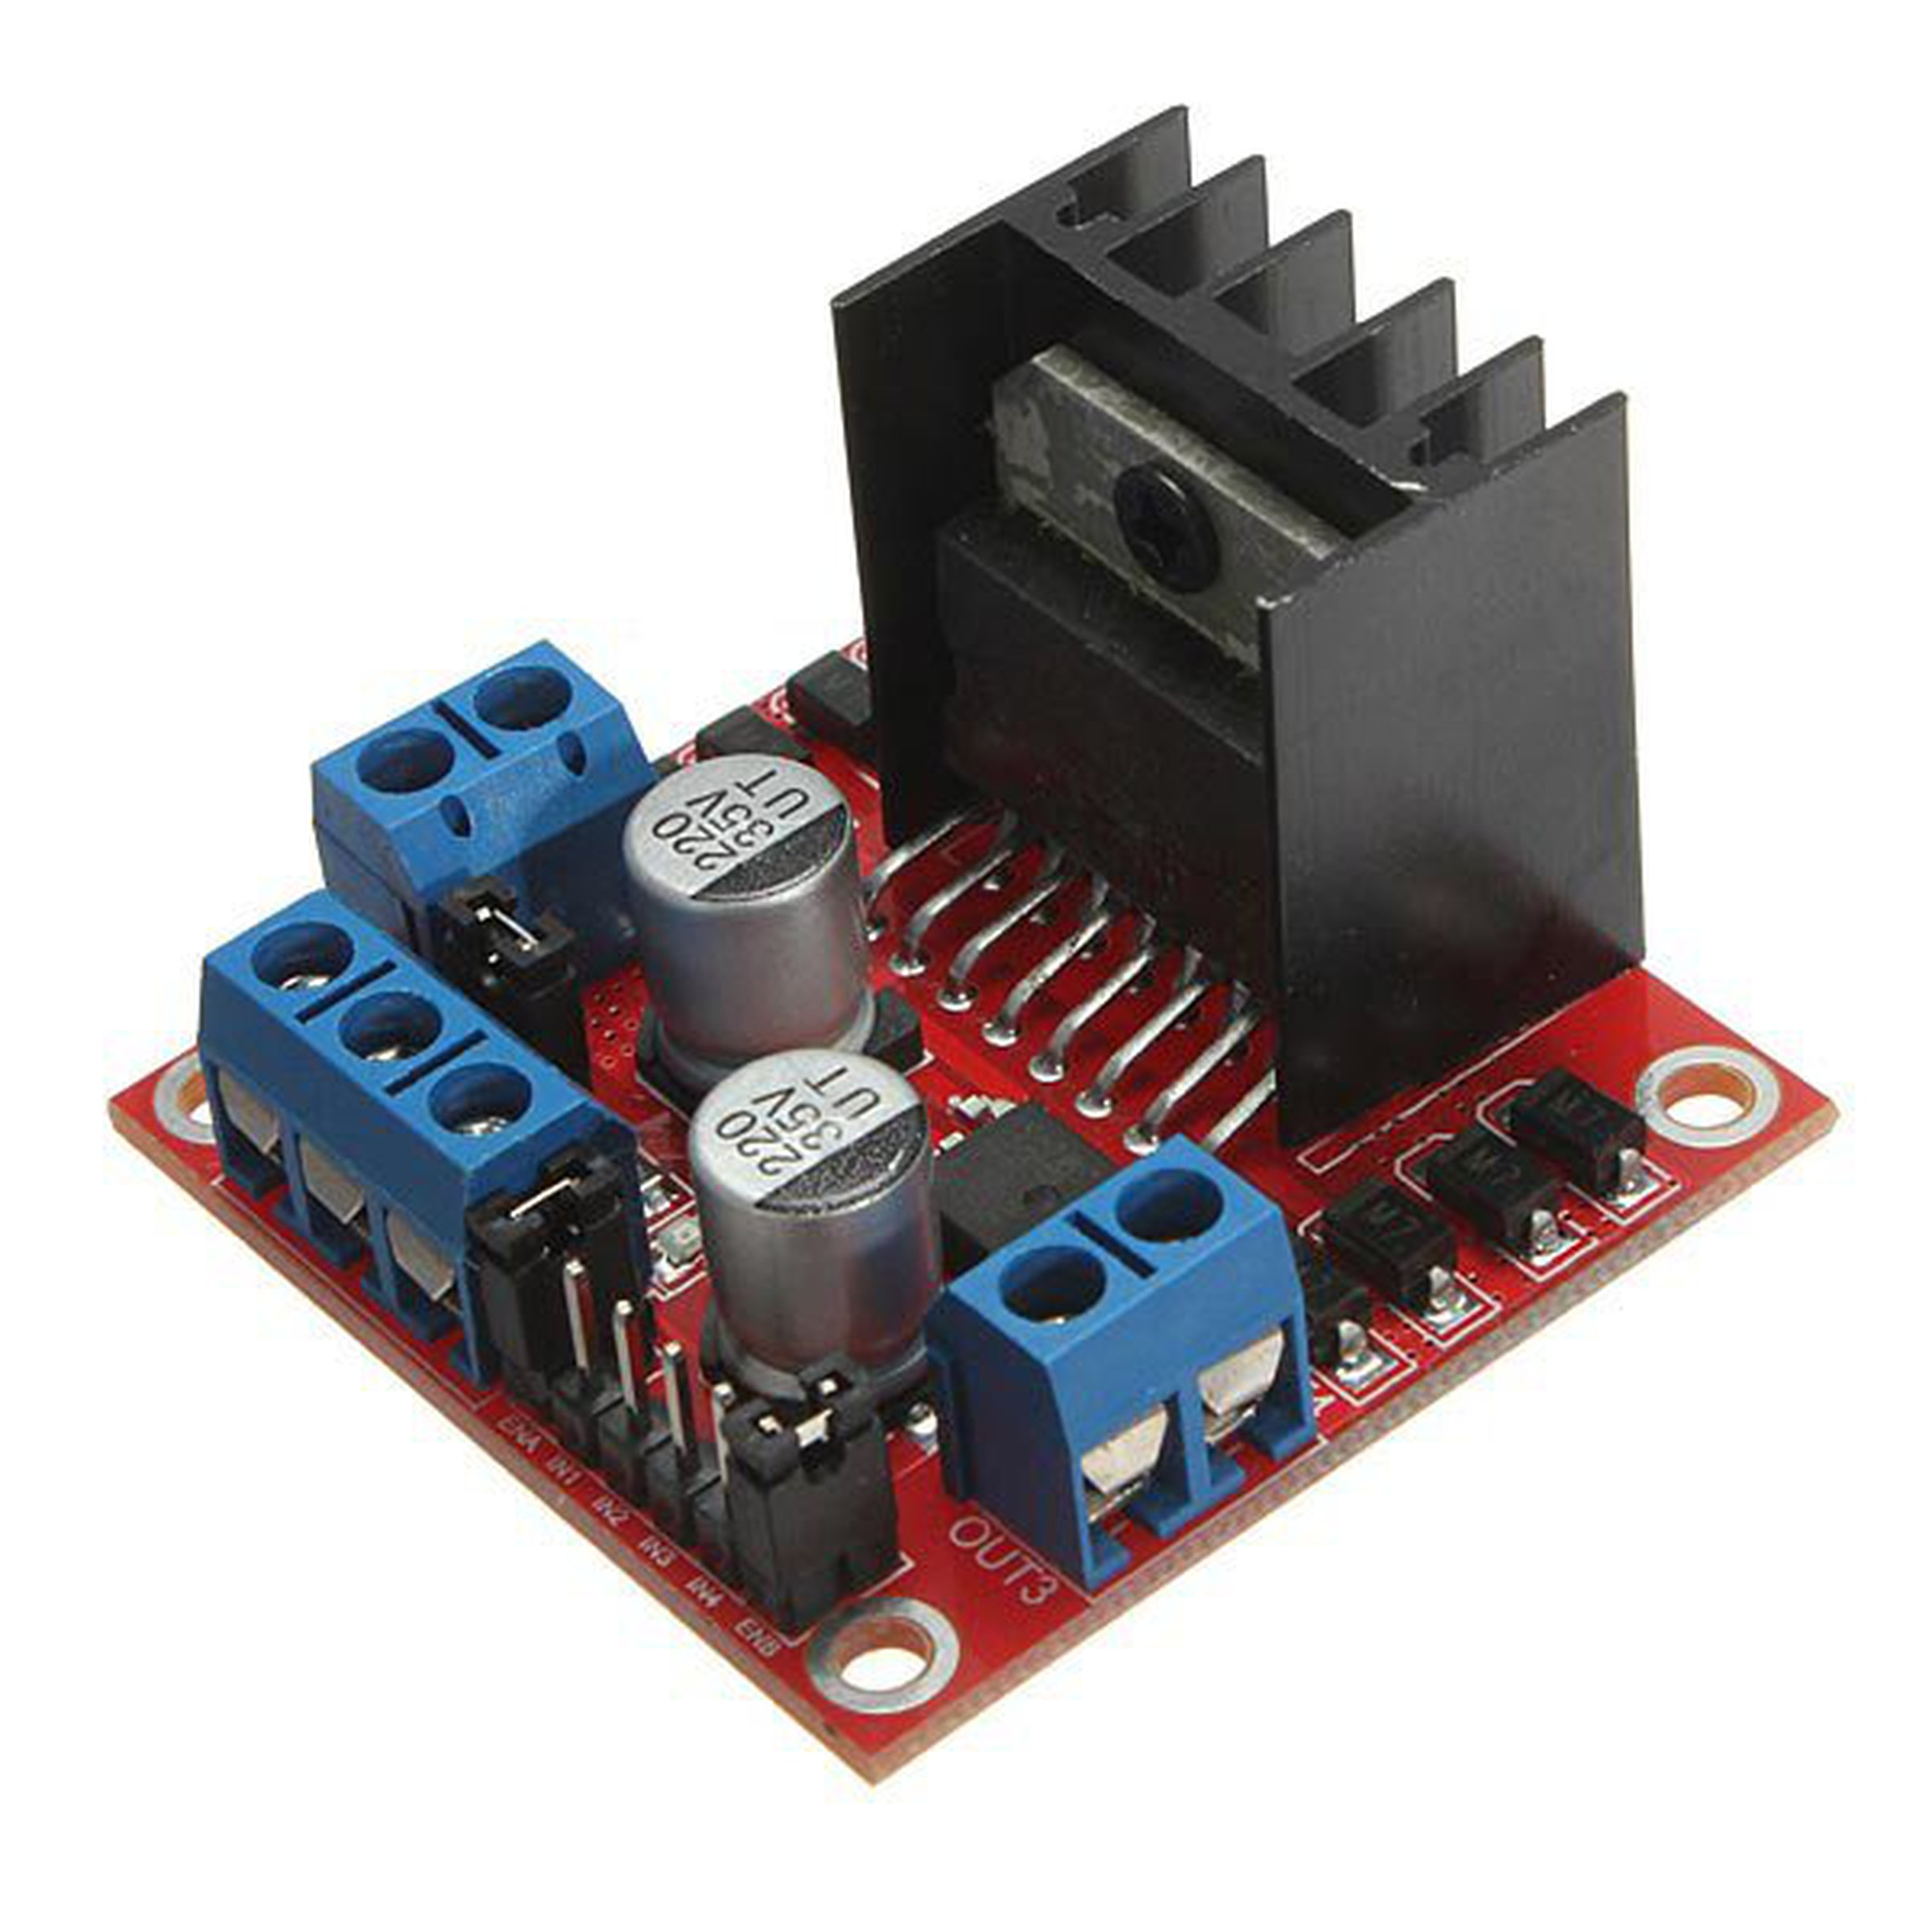
L298N MODULE:
Operating supply voltage up to 46 V
Over temperature protection (heat sink)
An onboard user-accessible 5V low-dropout regulator

Slide 14
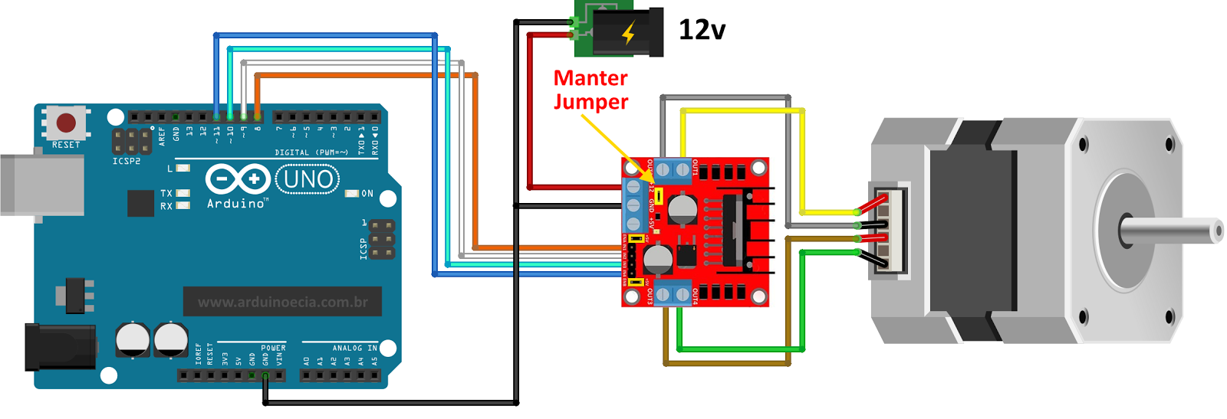
Arduino connected to motor through L298n
B+ B-
A+ A-

Slide 15
BUDGET:
Stepper motors(3 pcs) : 2325 INR
Arduinos (3 pcs) :
Motor shields (2 pcs) :
Worm gears (2pcs) : 300
Other (nails, screws etc) :
TOTAL:

Slide 16
ACKNOWLEDGEMENTS:
We convey our sincere thanks to:
Fabrication:
Ananthu sesikumar, JT Electrical.
Vinu D, Superindent, Workshop.
Ganesh, JT Mechanical.
Programming guidance:
Dileep Kumar (121601015)

Slide 17
PROBLEMS FACED:
No equipment available to make c shaped jaw for a helical gear
Wood of our desired properties was not available
Non availability of required components
Not able to supply required amount of power

